Slide 1
Appointment Management System
Xuan Ho
Adrian Mora
Mahmood Abuzaina

Slide 2

Problem Statement
Barber shops don’t have an efficient customer management system
Could be applied to other businesses as well

Slide 3
Concepts Used
Queue
LinkedList
Interfaces
Stacks
Binary Search Tree
Hashing Function
Quicksort
GUI (Java Swing)

Slide 4
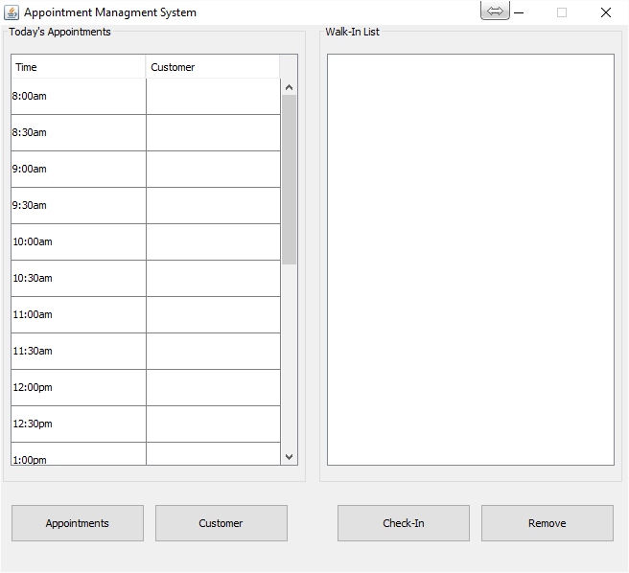
What does the program do?
Takes and stores appointments
Has a check-in system for people with no appointments
Stores customer information
Can search for a customer name and retrieves info

Slide 5
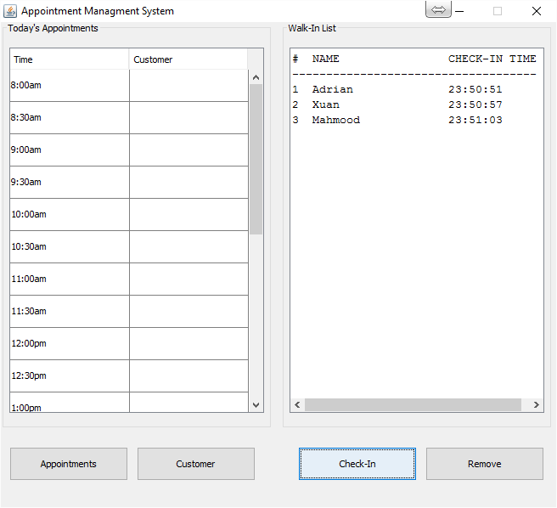
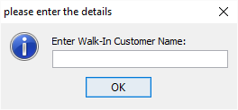
Check- In
When the check-in button is clicked, a Customer object is placed in the queue (Walk-in List).
Complexity is O(1) since the queue uses a linked list and the insertion happens right at the beginning of the chain.

Slide 6
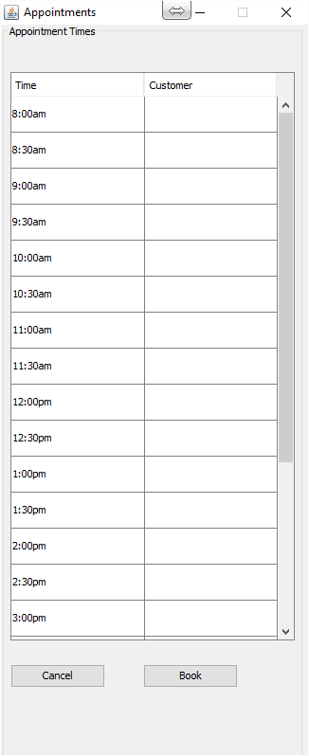
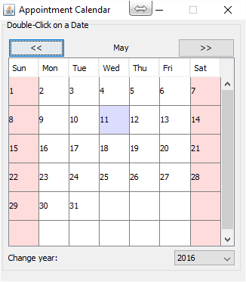
Appointment
---->
To book an appointment, a date on the calendar needs to be double-clicked, then a time slot needs to be selected if it’s still open.
Dates on calendar are represented by an array that can hold up to 2 years worth of dates.
Inside each calendar day element, we have AppointmentDay objects, which hold an array of time slots.
A hash function is used to retrieve a given array element.

Slide 7
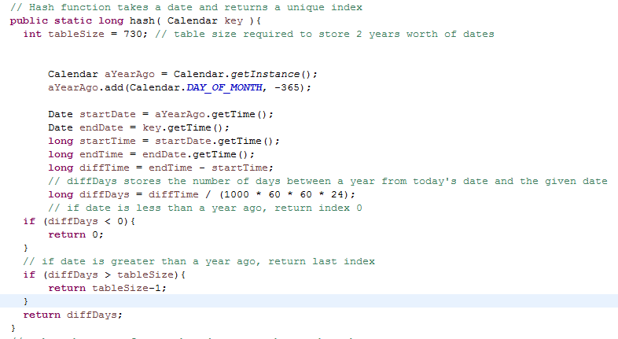
Hash Function

Slide 8
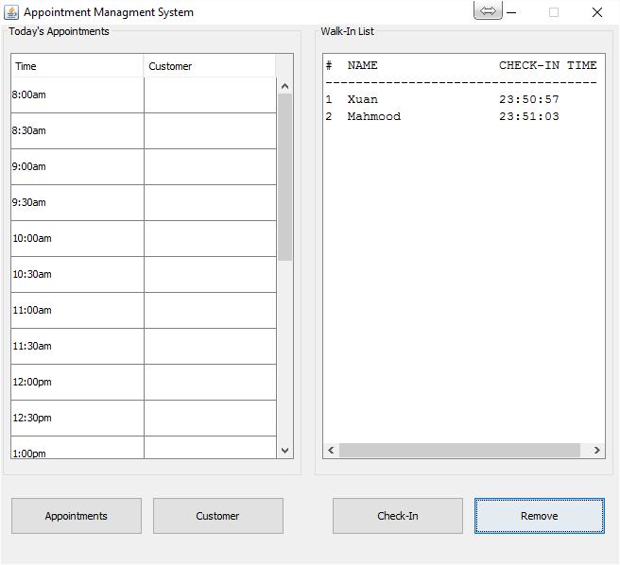
Remove
When the remove button is clicked, the #1 item is removed from the Walk-In List.
Since our queue uses a linked list, all the nodes would need to be traversed to complete the removal.
Therefore the remove has a complexity of O(n).

Slide 9
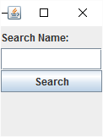
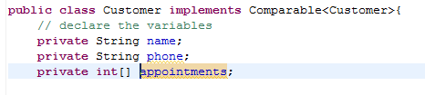
Customer
When the customer button is clicked, it prompts the user to type the customer name so that all the appointments for that customer can be retrieved.
We use a Binary Search Tree to store the customers, which means that the complexity to find a customer is O(logN).
A Customer object itself contains an array of the indexes that represent the dates and timeslots that the customer occupies.
Therefore displaying all the appointment dates for a customer is as simple as looping through an array, which has a complexity of O(n).

Slide 10
DEMO!

Slide 11
Future Enhancements
It could be integrated into a mobile app where the customers can pick an available appointment, and the business owner would get updates on his phone and the system immediately.

Slide 12
Conclusion
One of the most challenging part of this project was to finalize a conceptual design.
Another challenging parts of working as a group was to work on code independently and then put it back together.
The good things of working as a group is that we all were able to exchange ideas and collaboratively agree on the best design possible.
Working as a group on this project definitely provided some experience of what it might be like to work with a group of developers at a company.
Overall, we are really glad that we had the opportunity to use the tools that we have learned in class to create an application optimizing both the usage of space and runtime.

